Slide 1
COMP-520 Advanved Database Systems
Database Design
Dr. Evren Eryilmaz
Notes:
As stated in database basics, databases arise from three sources:
From existing data
From the development of new information systems
From re-design of existing databases
In this topic, we will consider the design of databases from existing data such as spreadsheets or extracts of existing databases

Slide 2
Table of Contents
Design Decisions
Relational Model Terminology
Functional Dependency
Keys in the Relational Model
Modification Anomalies
Normal Forms
Advantages and Disadvantages of Normalization
Forming Relationships
Common Design Problems
Normalization Exercises

Slide 3
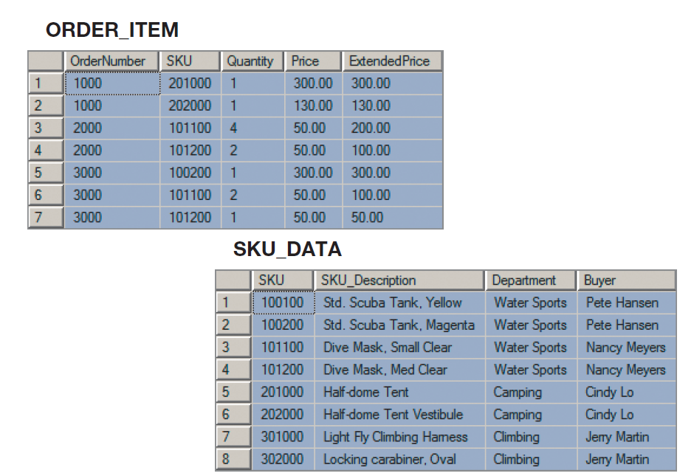
Design Decisions
Notes:
When designing a new database based on these tables the main question that we ask is: should this data be stored as is, or should it be transformed in some way before it is stored? By using this input, we can design a new database with two tables or we can join these tables together and offer customer a database with just one table. Each alternative has advantages and disadvantages. When we make the decision to use one design, we obtain certain advantages at the expense of certain costs. The purpose of this lecture is to help you understand those advantages and costs.

Slide 4
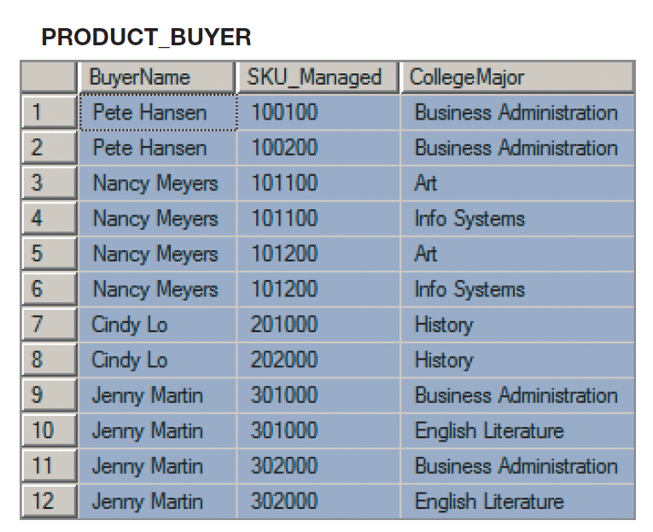
Design Decisions

Slide 5
Relational Model Terminology
Relation: Table with the characteristics below
Rows contain data about an entity
Columns contain data about attributes of the entities
All entries in a column are of the same kind
Each column has a unique name
Cells of the table hold a single value
The order of columns and rows is unimportant
No two rows may be identical

Slide 6
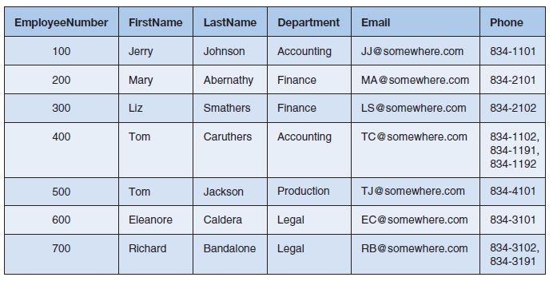
Cells of a Table Hold a Single Value
Notes:
Each cell of a relation should have only a single value or item. Multiple entries are not allowed. This table is not a relation because the phone values of employees Tom and Richard store multiple phone numbers.

Slide 7
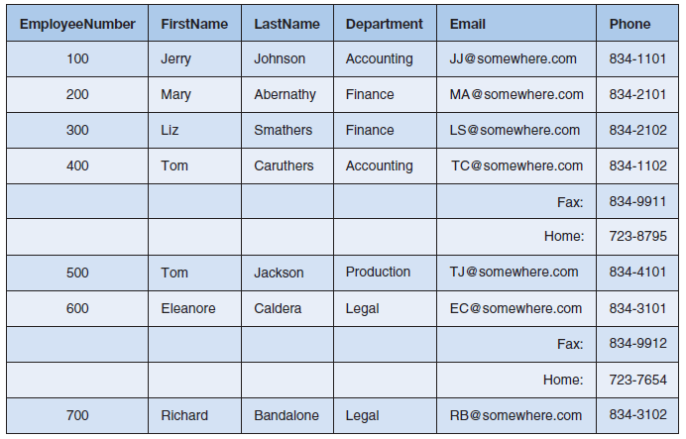
The order of the columns and rows is unimportant
Notes:
In a relation the order of the rows and columns is not important. This table is not a relation because the entries for Tom and Eleanor require a particular row arrangement. If the rows in this table were re-arranged, we would not know which employee has indicated Fax and Home numbers.
Go back to Slide 5.

Slide 8
Functional Dependency
CookieCost = NumberOfBoxes X $5
The above statement can be written as:
NumberOfBoxes → CookieCost
Notes:
Functional dependencies are at the heart of the database design process and it is vital for you to understand them. In general, a functional dependency exists when the value of one or more attributed determined the value of another attribute.
Let’s begin with a simple example. Suppose you are buying boxes of cookies and each box costs $5.00. With this fact, we can write the following formula.
In database design we express the relationship between CookieCost and NumberOfBoxes by saying that CookieCost depends on NumberOfBoxes or NumberOfBoxes determines CookieCost. The variable on the left is called the determinant.

Slide 9
Functional Dependency
ExtendedPrice = Quantity X UnitPrice
(Quantity, UnitPrice) → ExtendedPrice
Notes:
Expressing functional dependencies is important when designing highly normalized databases.

Slide 10
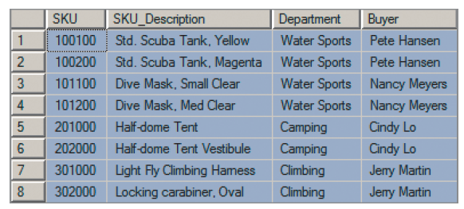
Finding Functional Dependencies
What functional dependencies exist in the table below?
Notes:
To find functional dependencies in a table, we must ask, does any column determine the value of another column?
Or
Every time, a value appears in column A does it match with the same value in column B? If yes, column A determines column B.

Slide 11
Finding Functional Dependencies
Buyer →Department
SKU→(SKU_Description, Department, Buyer)
SKU_Description → (SKU, Department, Buyer)

Slide 12
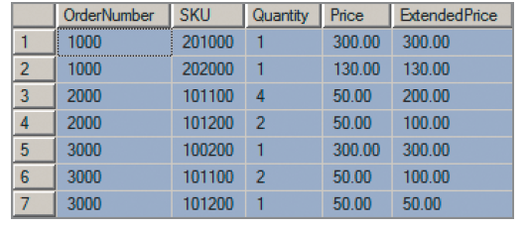
Finding Functional Dependencies
What are the functional dependencies in this table?

Slide 13
Keys in the Relational Model
Key: One or more columns that identify particular rows in a relation.
Candidate Key: A determinant that determines all of the other columns in a relation
Primary Key: A column (or combination of columns) that uniquely identifies each row in a table
Notes:
Candidate keys identify unique rows in a relation.
The table on slide 10 has 2 candidate keys:

Slide 14
Keys in the Relational Model
SKU → (SKU_Description, Department, Buyer)
SKU_Description →(SKU, Department, Buyer)

Slide 15
Keys in the Relational Model
SKU_DATA(SKU, SKU_Description, Department, Buyer)
ORDER_ITEM(OrderNumber, SKU, Quantity, Price, ExtendedPRice)
Notes:
When developing a data model, we can represent tables and the associated primary keys in this manner. We underline the relevant column(s) that comprise the primary key.

Slide 16
Keys in the Relational Model
Surrogate Key: An artificial column added to a table to serve as the primary key
RENTAL_PROPERTY(Street, City, State, ZipCode, Country, Rental_Rate)
RENTAL_PROPERTY(PropertyID, Street, City, State, ZipCode, Country, Rental_Rate)

Slide 17
Keys in the Relational Model
Foreign Key: A column (or combination of columns) that is the primary key of another table
DEPARTMENT(DepartmentName, BudgetCode, ManagerName)
EMPLOYEE (EmployeeNumber, EmployeeName, DepartmentName)
Notes:
We use foreign keys to link one table to another table. A foreign key in a table serves as primary key in another table.
In these table examples, DepartmentName is the primary key of the Department Table and it is the foreign key in the Employee table. In a data model, we typically show foreign keys in italics.
Foreign keys express relationships between rows of tables. In this example, the foregin key department name in the employee table stores the relationship between an employee and his or her department.

Slide 18
Keys in the Relational Model
SKU_DATA(SKU, SKU_Description, Department, Buyer)
ORDER_ITEM(OrderNumber, SKU, Quantity, Price, ExtendedPrice)
Referential Integrity Constraint Example
ORDER_ITEM.SKU must exist in SKU_DATA.SKU
Notes:
Consider the following two tables. SKU is the primary key of the SKU_DATA table. SKU is also the part of the primary key in the ORDER_ITEM table. However, unlike the previous example, SKU also serves as the foreign key in the order item table in order to connect SKU_DATA and ORDER_ITEM tables. In most cases, we need to ensure that the values of a foreign key match a valid value of a primary key. To accomplish this, we create referential integrity constraints.

Slide 19
Modification Anomalies
Insertion Anomaly: Occurs when the structure of a table forces us to enter facts about multiple entities when we just want to enter facts about one.
Student_ID | CLASS_ID | CLASS_TITLE | INSTRUCTOR
562321124 | IST-189 | BASIC COMPUTER PROCESSING | SAMUAL MOORE
562321124 | IST-189 | BASIC COMPUTER PROCESSING | ADRIAN JONES
769017832 | IST-250 | ADVANCED COMPUTER PROCESSING | JAMES WILSON
989832423 | OST-223 | DATA PROCESSING | SAMUEL MOORE
908769987 | IST-289 | PROGRAMMING METHODS | NORMAN YOUNG
179077643 | IST-220 | BASIC PROGRAMMING | TAMMY GREEN

Slide 20
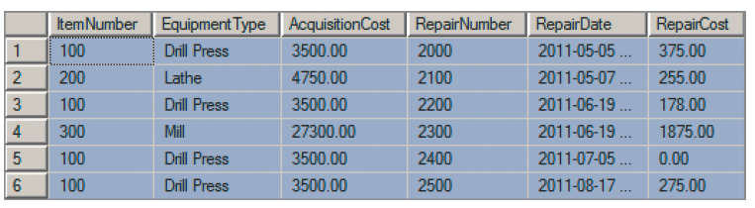
Another Insertion Anomaly Example

Slide 21
Modification Anomalies
Deletion Anomaly: Occurs when the structure of a table forces us to lose facts about multiple entities.
Student_ID | CLASS_ID | CLASS_TITLE | INSTRUCTOR
562321124 | IST-189 | BASIC COMPUTER PROCESSING | SAMUAL MOORE
562321124 | IST-189 | BASIC COMPUTER PROCESSING | ADRIAN JONES
769017832 | IST-250 | ADVANCED COMPUTER PROCESSING | JAMES WILSON
989832423 | OST-223 | DATA PROCESSING | SAMUEL MOORE
908769987 | IST-289 | PROGRAMMING METHODS | NORMAN YOUNG
179077643 | IST-220 | BASIC PROGRAMMING | TAMMY GREEN

Slide 22
Another Deletion Anomaly Example

Slide 23
Modification Anomalies
Update Anomaly: Occurs when the structure of a table forces us to change multiple rows to modify only a single fact
Student_ID | CLASS_ID | CLASS_TITLE | INSTRUCTOR
562321124 | IST-189 | BASIC COMPUTER PROCESSING | SAMUAL MORE
562321124 | IST-189 | BASIC COMPUTER PROCESSING | ADRIAN JONES
769017832 | IST-250 | ADVANCED COMPUTER PROCESSING | JAMES WILSON
989832423 | OST-223 | DATA PROCESSING | SAMUEL MORE
908769987 | IST-289 | PROGRAMMING METHODS | NORMAN YOUNG
179077643 | IST-220 | BASIC PROGRAMMING | TAMMY GREEN

Slide 24
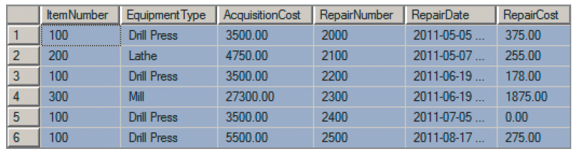
Another Update Anomaly Example

Slide 25
Normal Forms
The requirements to satisfy the 1st Normal Form:
Each table has a primary key: minimal set of attributes which can uniquely identify a record
The values in each column of a table are atomic (no multi-value attributes are allowed)
There are no multiple columns
See characteristics of a relation!

Slide 26
1st Normal Form Example
Un-normalized table:
Is it 1NF?
MANAGER | EMPLOYEES
James | Jerry, Mary
Smith | Tom, Richard
MANAGER | EMPLOYEE1 | EMPLOYEE2
James | Jerry | Mary
Smith | Tom | Richard

Slide 27
1st Normal Form Example
Table in the 1st normal form
EMPLOYEE | MANAGER
Jerry | James
Mary | James
Tom | Smith
Richard | Smith

Slide 28
Moving to 2nd Normal Form
The requirements to satisfy the 2nd Normal form are:
All requirements for 1st NF must be met.
Redundant data across multiple rows of a table must be moved to a separate table.
The resulting tables must be related to each other by use of foreign key.

Slide 29
2nd Normal Form Example
This table is in 1NF: all fields are atomic and the CustomerID serves as the primary key
CUSTOMERID | FIRSTNAME | LASTNAME | ADDRESS | CITY | STATE | ZIPCODE
1 | Bob | Smith | 123 Main St. | Tucson | AZ | 12345
2 | John | Brown | 555 2nd Ave. | St. Paul | MN | 54355
3 | Sandy | Jessop | 4256 James St. | Chicago | IL | 43555
4 | Gameil | Hintz | 569 Summit St. | St. Paul | MN | 54355
5 | Shiela | Green | 12 Michigan Ave. | Chicago | IL | 43555

Slide 30
2nd Normal Form Example
CUSTOMERID | FIRSTNAME | LASTNAME | ADDRESS | ZIPCODE
1 | Bob | Smith | 123 Main St. | 12345
2 | John | Brown | 555 2nd Ave. | 54355
3 | Sandy | Jessop | 4256 James St. | 43555
4 | Gameil | Hintz | 569 Summit St. | 54355
5 | Shiela | Green | 12 Michigan Ave. | 43555
Customer Table
ZipCode Table
ZIPCODE | CITY | STATE
12345 | Tucson | AZ
54355 | St. Paul | MN
43555 | Chicago | IL

Slide 31
Summary of 1NF and 2NF
1NF:
Each table has a primary key
The values in each column of a table are atomic
There are no multiple columns
See characteristics of a relation!
2NF:
All requirements for 1NF must be met
Repeating data of a table must be moved to a separate table

Slide 32
Moving to 3rd Normal Form
The requirements to satisfy the 3rd normal form:
All requirements for 2nd normal form must be met.
All columns in a table must depend only on the primary key and not on any other field in the table
Any field which is dependent not only on the primary key but also on another field is moved out to a separate table.

Slide 33
3rd Normal Form Example
ORDERID | CUSTOMERID | PRODUCTID | PRICE | QUANTITY | TOTAL
1 | 1001 | AB-111 | 50 | 1000 | 50000
2 | 1002 | AB-111 | 60 | 500 | 30000
3 | 1001 | ZA-245 | 35 | 100 | 3500
4 | 1003 | MB-153 | 82 | 25 | 2050
5 | 1004 | ZA-245 | 42 | 10 | 420
6 | 1002 | ZA-245 | 40 | 50 | 2000
7 | 1001 | AB-111 | 75 | 100 | 7500

Slide 34
3rd Normal Form Example
ORDERID | CUSTOMERID | PRODUCTID | QUANTITY
1 | 1001 | AB-111 | 1000
2 | 1002 | AB-111 | 500
3 | 1001 | ZA-245 | 100
4 | 1003 | MB-153 | 25
5 | 1004 | ZA-245 | 10
6 | 1002 | ZA-245 | 50
7 | 1001 | AB-111 | 100
Order Table
PRODUCTID | QUANTITY | PRICE
AB-111 | 1 | 75
AB-111 | 101 | 60
AB-111 | 501 | 50
ZA-245 | 1 | 42
ZA-245 | 11 | 40
ZA-245 | 51 | 35
MB-153 | 1 | 82
Pricing List Table

Slide 35
Summary of 1NF, 2NF, and 3NF
A database is in 3NF if:
It is in 2NF
It has no transitive dependencies
A database is in 2NF if:
It is in 1NF
There is no repeating data in its tables
A database is in 1NF if:
All rows have a unique primary key
The values in each column of a table are atomic
There are no multiple columns (e.g., EMPLOYEE1, EMPLOYEE2…)

Slide 36
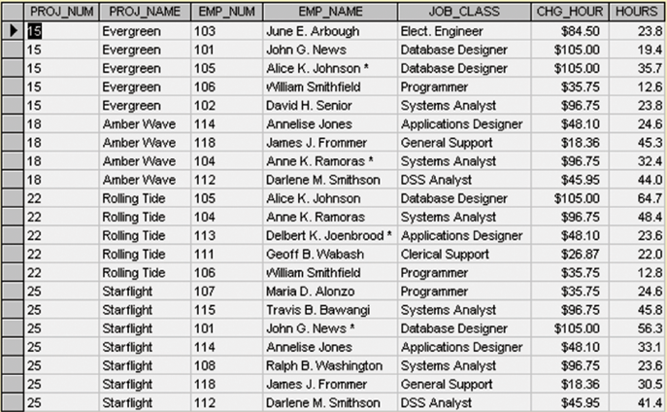
Normalization Exercise 1
Convert the following un-normalized table to the 3rd NF
Notes:
Assumptions:
An employee can have 1 job
Hourly Billing rate (CHG_HOUR) depends on employee’s position

Slide 37
Normalization Exercise 2
Convert the following un-normalized table to the 3rd NF
Rep ID | Rep First Name | Rep Last Name | Client ID | Client | Time With Client
TS-89 | Gilroy | Gladstone | 978 | US Corp | 14 hrs
TS-89 | Gilroy | Gladstone | 665 | Taggarts | 26 hrs
TS-89 | Gilroy | Gladstone | 782 | Kilroy Inc. | 9 hrs
RK-56 | Mary | Mayhem | 221 | Italiana | 67 hrs
RK-56 | Mary | Mayhem | 982 | Linkers | 2 hrs

Slide 38
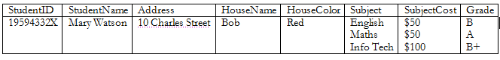
Normalization Exercise 3
Convert the following un-normalized table to the 3rd NF

Slide 39
Normalization Exercise 3
StudentID | StudentName | Address | House Name | House Color | Subject | SubjectCost | Grade
19594332X | Mary Watson | 10 Charles Street | Bob | Red | English | $50 | B
19594332X | Mary Watson | 10 Charles Street | Bob | Red | Maths | $50 | A
19594332X | Mary Watson | 10 Charles Street | Bob | Red | Info Tech | $100 | B+
Notes:
Assumption: Subject determines subject cost

Slide 40
Normalization Exercise 4
Convert the following un-normalized table to the 3rd NF
item | colors | price | tax
T-shirt | red,blue | 12.00 | 0.60
Polo | red,yellow | 12.00 | 0.60
T-shirt | red,blue | 12.00 | 0.60
sweatshirt | blue,black | 25.00 | 1.25

Slide 41
Normalization Exercise 4
item | color | price | tax
T-shirt | red | 12.00 | 0.60
T-Shirt | blue | 12.00 | 0.60
polo | red | 12.00 | 0.60
polo | yellow | 12.00 | 0.60
sweatshirt | blue | 25.00 | 1.25
sweatshirt | black | 25.00 | 1.25

Slide 42
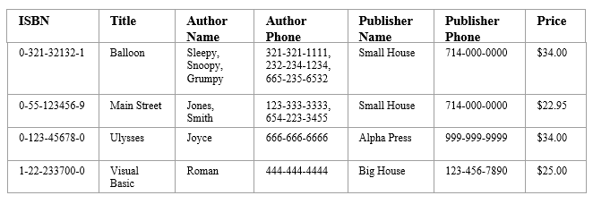
Normalization Exercise 5
Convert the following un-normalized table to the 3rd NF

Slide 43
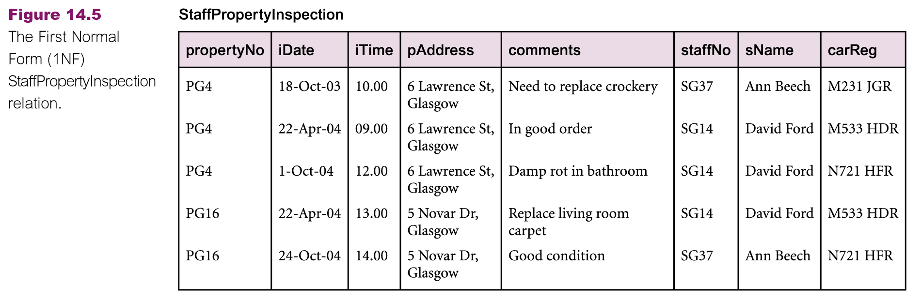
Normalization Exercise 6
Convert the following un-normalized table to the 3rd NF
Notes:
Assumption: An Employee takes any available car on an inspection day to go to a property

Slide 44
Normalization Exercise 7
Notes:
Assumption: A surgeon can perform multiple surgeries on a patient.

Slide 45
Normalization Exercise 7

Slide 46
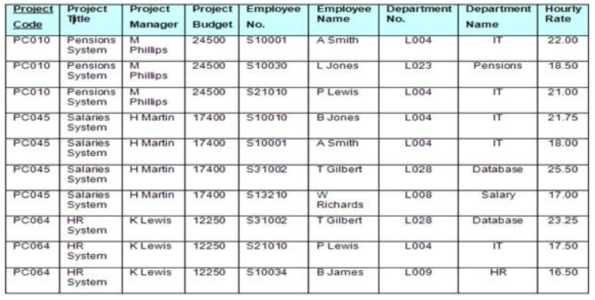
Normalization Exercise 8
Convert the following un-normalized table to the 3rd NF

Slide 47
Advantages and Disadvantages of Normalization
Advantages
Eliminate modification anomalies
Reduce duplicated data
Disadvantages
More complicated SQL required for joins
Extra work for DBMS can mean slower applications

Slide 48
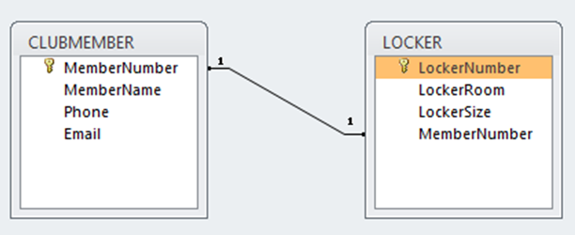
Forming Relationships
One to One Relationship: Occur when each entry in the first table has one, and only one, counterpart in the second table.

Slide 49
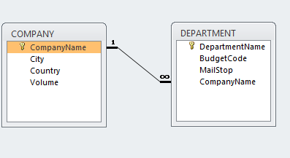
Forming Relationships
One to Many Relationship: Occurs when one row in the first table corresponds to many rows in the second table

Slide 50
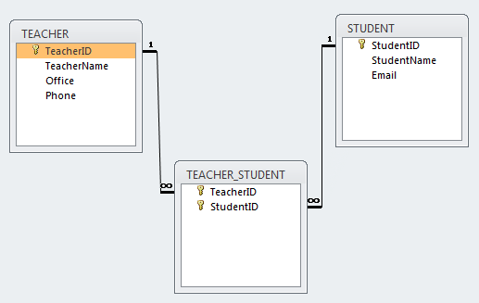
Forming Relationships
Many to Many Relationship: Occurs when multiple rows from table A correspond to multiple rows in table B

Slide 51
Designing Read-Only Databases
Read-only databases are used for querying, reporting, and data mining applications.
Normalization is seldom an advantage

Slide 52
Common Design Problems
1. Multivalue, Multicolumn problem:
Problem Example:
EMPLOYEE(EmpNumber, Name, Email, Auto1_LicenseNumber, Auto2_LicenseNumber, Auto3_LicenseNumber)

Slide 53
Common Design Problems
2. Inconsistent Values: Occurs because different users or different data sources may use different forms of the same data value.
3. Missing (Null) Values: The problem with null values is ambiguity

